Slide 1

WAY TO ENTERPRISE
AWS
VTI ACADEMY
Author: duy.nguyenngoc1@vti.com.vn

Slide 2
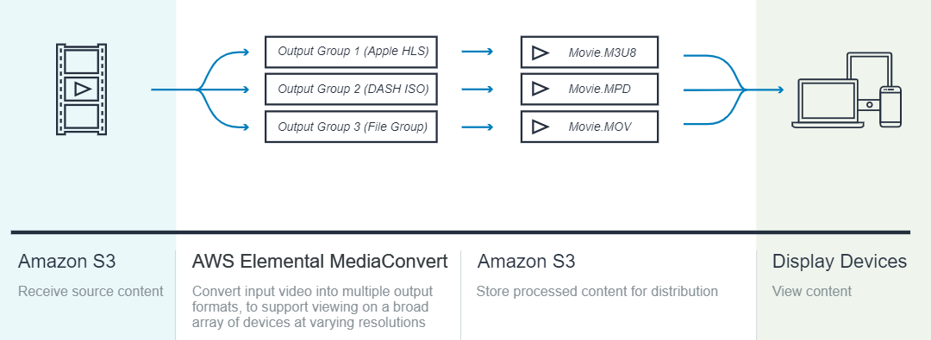
MediaConvert Service
Is a file-based video processing service that allows easily create video-on-demand (VOD) content for broadcast and multiscreen delivery at scale
Tutorial: https://docs.aws.amazon.com/mediaconvert/latest/ug/what-is.html

Slide 3
MediaConvert Service
Demo
  https://www.youtube.com/watch?v=W_mSzZzveqE
  https://www.youtube.com/watch?v=l_MhKOe7VxE
  https://www.youtube.com/watch?v=EIBDzSUIDFA

Slide 4
Q & A
Copyright © VTI Academy All Rights Reserved

